Slide 1
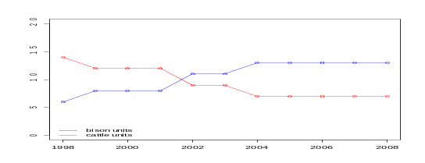
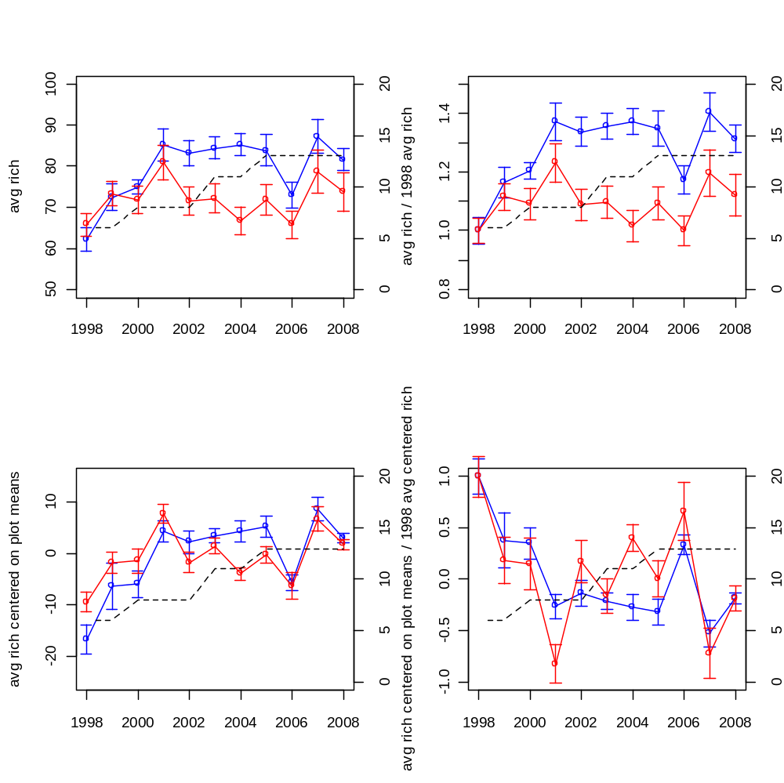
# of bison quadrats (see right axis)
Notes:
--it appears that with the exception of the first few years of the study that bison sites have a higher mean species richness
--What these graphics do not show convincingly, is that bison sites are increasing in richness through time at a greater rate than cattle sites.
--

Slide 2
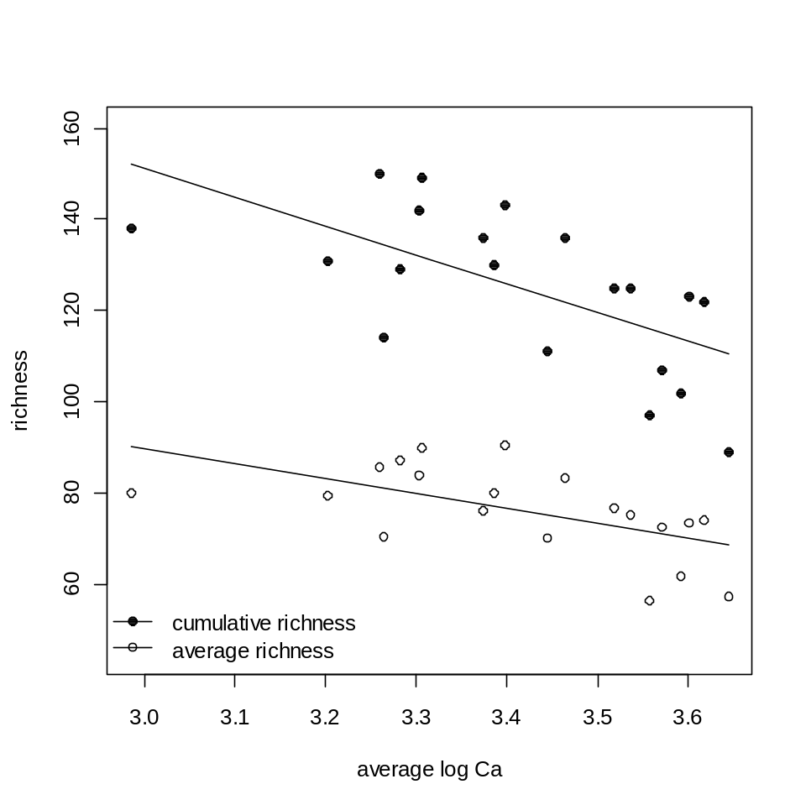
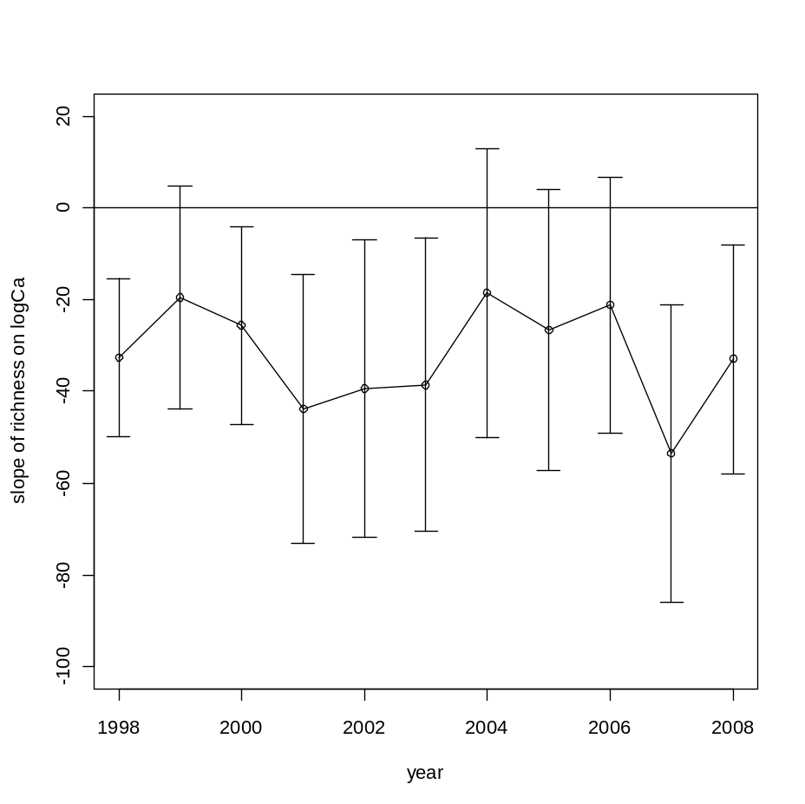
Figs from Folia Soil Reaction paper – with more years of data
Fig 4 – Nothing new here
Fig 5 – nothing new here either
Notes:
--Continuation of the graphics in your Folia paper

Slide 3
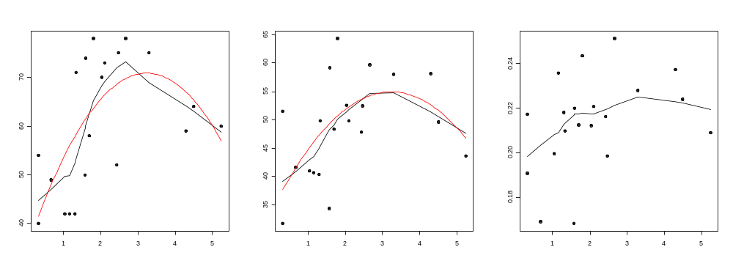
log₁₀Total Richness – log₁₀Mean Richness
Total Richness – 1998 Richness
Total Richness – Mean Richness
Average Years Since Last Burn over 11 year period

Slide 4
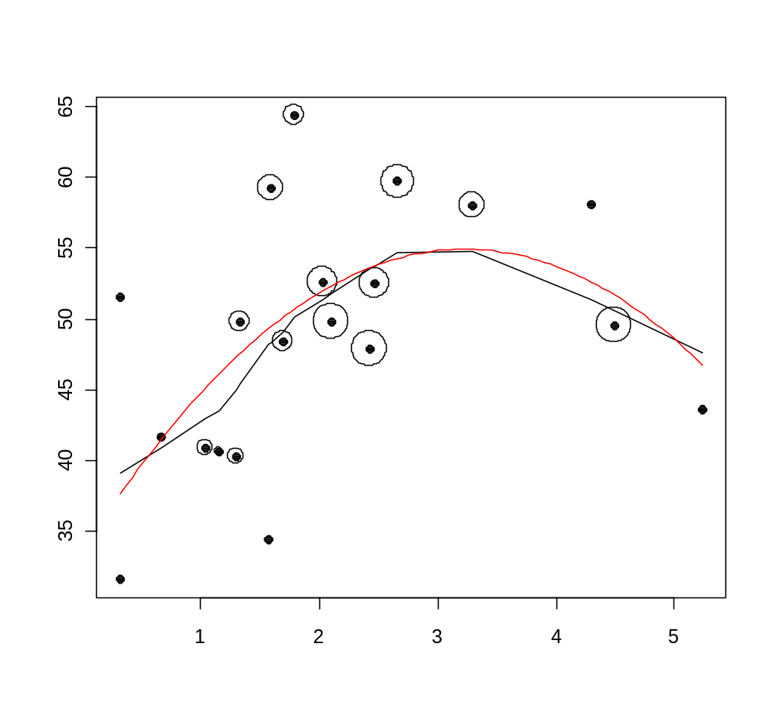
Area of ring around each point is directly proportional to length of bison grazing
Total Richness – Mean Richness
Average Years Since Last Burn over 11 year period
Notes:
--A bit of a problem is the confounded nature of average years since last burn and the grazer on the plot. The standard tallgrass prairie mantra is that bison increase plant richness because they prefer grasses and therefore release forbs from competition. This may be the driver of this pattern or it could be that intermediate periods of time since fire are the best for largest gains in diversity over time. With our data we cannot really say which is the driver.

Slide 5
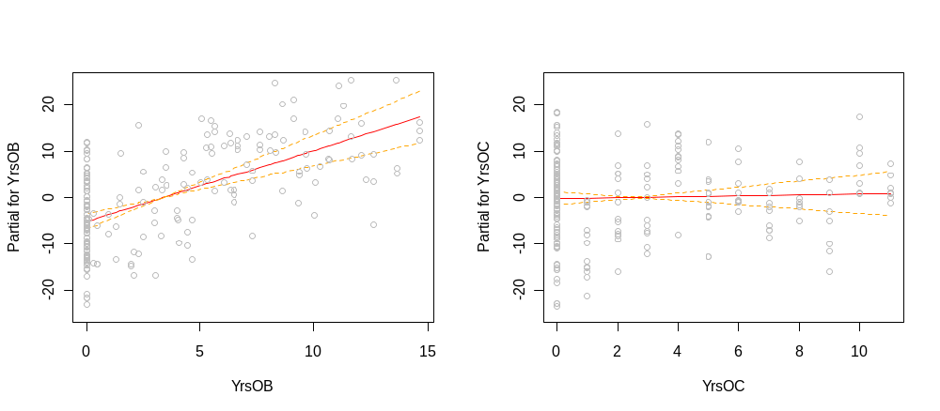
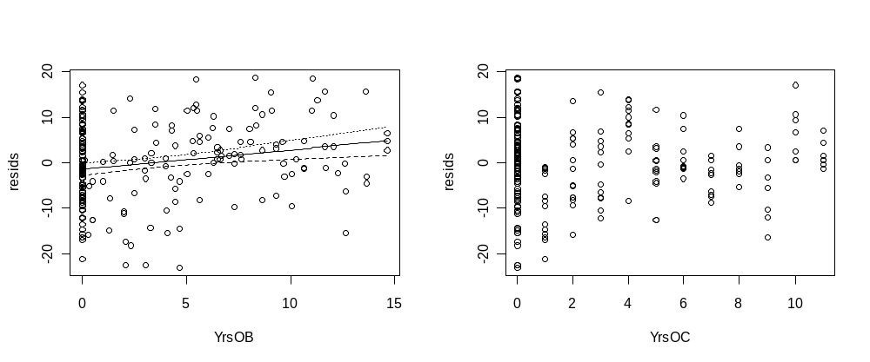
Rich ~ plot.id + Years of bison
Rich ~ plot.id + Years of cattle

